Slide 1


Lecture 4: Evaluation, Applications, and Trends in LLM-Driven Information Retrieval
Lecturer: Yunfei Long
Duration: 90 minutes
Module Organizer: Qianni Zhang

Slide 2
Why Evaluating LLM-based IR Is Harder Than Classical IR?
From “Retrieval Accuracy” to “System Quality”
Different procedure:
Classical IR: query → ranked list
LLM-based IR: query → retrieval → ranking → generation → explanation
Evaluation mismatch:
Good retrieval ≠ good answer
Good answer ≠ faithful retrieval
faithful retrieval ≠ useful retrieval

Slide 3
Scenario: Medical Question Answering (RAG Based System)
User query:
“What are the main treatments for Type 2 diabetes?”
Retriever → Re-ranker → LLM Generator
Case 1: Good Retrieval ≠ Good Answer
The retriever returns:
Clinical guideline on Type 2 diabetes treatment ✅
WHO report on diabetes management ✅
Review paper on insulin therapy ✅
Retrieval metrics:
Recall@5 = 1.0
nDCG@10 = very high
📌 From a classical IR perspective, the system is doing perfectly.

Slide 4
Good Retrieval ≠ Good Answer
The LLM generates: “Type 2 diabetes is mainly treated with insulin injections and, in severe cases, pancreas transplantation.”
❌ Problems:
Over-emphasizes insulin
Mentions pancreas transplantation (rare, misleading)
Ignores lifestyle and oral medication (like Metformin)
Potentially dangerous! Actually, a lot of medical doctors complain this!
Over weights salient phrases
Hallucinates plausible but incorrect treatments
Fails to summarize faithfully
Especially in low-resources languages

Slide 5
Good Answer ≠ Faithful Retrieval
The LLM generates:
“Type 2 diabetes is usually managed with lifestyle changes, oral medications like metformin, and insulin if needed.”
✔️ Medically correct ✔️ Well-written ✔️ Helpful to users
🔍 The retrieved documents in Retrieval Stage were:
Outdated blog post on diabetes (did not mention newer drugs like Competact) ❌
General nutrition article ❌
Irrelevant discussion forum ❌
The LLM:
Used pretrained knowledge
Ignored retrieved evidence
Did not ground the answer in sources

Slide 6
Faithful retrieval ≠ useful retrieval
Scenario: Enterprise Policy QA System
User query: “Can employees work remotely from abroad?”
Faithful retrieval: Retrieved documents actually contain information relevant to the query and are correctly retrieved.
🔍 Retrieved Documents (All Faithful)
Full HR Policy Handbook (2023) — 120 pages
Contains the remote work policy ✔️
Mentions overseas work conditions ✔️
Legal Compliance Appendix — 40 pages
Accurately discusses tax residency ✔️
Mentions international labor law ✔️
Internal Risk Assessment Memo
Discusses cross-border employment risks ✔️

Slide 7
Why This Retrieval Is Not Useful
From the user’s perspective:
Too long
Too verbose
Too legalistic
Hard to extract a clear answer
Hence the LLM:
Struggles to fit content into context window
May focus on edge cases
Produces vague or hedged answers
🚨 Outcome：“Remote work from abroad depends on multiple legal, tax, and organizational factors and may require approvals.”
✔️ Faithful ❌ Not actionable❌ Not helpful

Slide 8
What Changes with LLMs?
Highlight 4 challenges:
Multi-stage pipelines
Reasoning & generation involved
Non-determinism
User-facing outputs (answers, summaries)

Slide 9
Non-Determinism in LLM-Based IR
Aspect | Run 1 | Run 2
Query | What are the main limitations of RAG? | What are the main limitations of RAG?
Retrieved documents | Same set of papers | Same set of papers
LLM temperature | Low / fixed | Low / fixed
Generated answer | “The main limitations of RAG include retrieval errors, context window constraints, and the propagation of irrelevant documents into generation.” | “RAG systems suffer primarily from hallucination caused by noisy retrieval, inefficient ranking, and misalignment between retrieval and generation.”
Emphasis | Retrieval errors & context limits | Hallucination & ranking misalignment
Tone | Descriptive | Analytical
Source attribution | Survey + benchmark | Hallucination + ranking studies
Correctness | ✔️ Correct | ✔️ Correct
Output identical? | ❌ | ❌
If you are a RA doing Academic Literature Search
User query: “What are the main limitations of Retrieval-Augmented Generation?”

Slide 10
The effect of different prompts
Prompt instruction | “Summarize the main limitations of RAG.” | “Critically analyze the main limitations of RAG.”
Generated answer | “RAG systems are limited by retrieval errors, context window constraints, and dependency on document quality.” | “RAG systems fundamentally suffer from misalignment between retrieval and generation, which amplifies hallucination when ranking fails.”
Rankings, summaries, and judgments are not prompt-invariant
Small wording changes can:
Shift emphasis
Change conclusions
Alter which evidence is highlighted

Slide 11
Non-determinism vs Prompt sensitivity
Both break:
Reproducibility
Fair benchmarking
Simple metric-based evaluation
Source of variation | What changes
Non-determinism | Sampling / internal randomness
Prompt sensitivity | Task framing / instruction

Slide 12

User-Facing Outputs vs Classical IR Metrics
A Business project assistant put a user query: “How do I request reimbursement for business travel?”
Classical IR Evaluation (Looks Good)
Retrieved documents:
Company Expense Policy PDF (30 pages)
Company Finance Procedures Manual
Travel Policy Addendum
Metrics:
Recall@5 = 1.0
nDCG@10 = high
✔️ From an IR perspective: excellent retrieval

Slide 13
User-Facing Outputs vs Classical IR Metrics 2
In LLM-based IR, the evaluated object is the user-facing answer, not the ranked list:
“Reimbursement depends on compliance with corporate expense policies and requires appropriate documentation and approval.”
❌ Problems:
Vague
No steps
No forms
No timeline
You would expect LLMs provide you step by step instructions!

Slide 14
Why End-to-End Evaluation Matters
RAG systems fail even when retrieval metrics look good.
Introduce typical failure modes:
Correct docs retrieved but ignored
Irrelevant docs dominating context
Hallucination despite evidence

Slide 15
Hallucination despite evidence
How Can an LLM Be Wrong When the Right Documents Are Present?
Example query: “Does vitamin C prevent the common cold?”
The system is a RAG-based QA assistant.
Let us say how this assistant performed?

Slide 16
Hallucination example
Step 1 Retrieval (Correct and Faithful)
The retriever returns:
Cochrane Review (2013)
“Vitamin C does not reduce the incidence of the common cold in the general population.”
Meta-analysis (BMJ)
“Routine vitamin C supplementation shows no preventive effect.”
WHO Summary
“No conclusive evidence supports vitamin C as a preventive measure.”
✔️ Retrieval is high recall ✔️ Evidence is correct and consistent

Slide 17
Hallucination example
Step 2 What the LLM Sees in Context
The context window contains:
Multiple mentions of:
“Vitamin C”
“immune function”
“reduced duration”
Long, nuanced scientific language
Hedged statements (“does not significantly reduce…”)

Slide 18
Hallucination example
Step 3 Generated Answer (Hallucination)
LLM output: “Vitamin C has been shown to boost immune function and may help prevent the common cold, particularly when taken regularly.”
❌ This is incorrect ❌ It contradicts the retrieved evidence
Acceptable Faithful result might be: “Based on multiple systematic reviews, vitamin C does not prevent the common cold in the general population, although it may slightly reduce symptom duration.”
✔️ Grounded ✔️ Faithful ✔️ Evidence-aligned

Slide 19
Faithfulness, Grounding, and Attribution
Faithfulness: Is the answer supported by retrieved docs?
Grounding: Are claims traceable to evidence?
Attribution: Can we point to sources?

Slide 20
Faithfulness
Faithfulness measures whether the claims made in the generated answer are entailed by the retrieved documents.
It is about the relationship between answer and evidence, not about correctness in the real world.
Does the answer introduce facts not present in the retrieved docs?
Does it contradict retrieved evidence?
Does it overgeneralize or exaggerate?

Slide 21
Faithfulness example
Query: “Does vitamin C prevent the common cold?”
Retrieved document says:“Vitamin C does not reduce the incidence of the common cold in the general population.”
Generated answer: “Vitamin C helps prevent the common cold by boosting immune function.”
❌ Not faithful Even though the document was retrieved correctly, the answer contradicts it.

Slide 22
Grounding
Are the claims in the answer traceable to specific evidence?
Grounding measures whether each claim in the answer can be linked to concrete content in the retrieved documents.
Grounding is about traceability, not citation format.
Can we point to where in the documents each claim comes from?
Are claims supported by identifiable passages?
Or are they vague, implicit, or inferred?

Slide 23
Grounding: an example
Generated answer: “Vitamin C slightly reduces symptom duration in some populations.”
This claim may be true, but:
The retrieved documents:
Mention prevention only
Do not discuss symptom duration
⚠️ Weak grounding
The claim is not traceable to retrieved evidence
The answer partially “floats free” of the context

Slide 24
What is a strong grounding answer like?
✅ Strong Grounding: What It Should Look Like
Strongly Grounded Answer 1 “Based on the retrieved studies, vitamin C does not prevent the common cold in the general population.”
Every claim is directly supported
No additional facts are introduced
The answer stays within the evidence boundary
Strongly Grounded Answer 2 “The retrieved reviews report that vitamin C does not reduce the incidence of the common cold in the general population. The documents do not provide evidence about symptom duration.”
Claims are traceable
Absence of evidence is explicitly acknowledged
does not speculate

Slide 25
Attribution
Attribution asks whether each claim in the generated answer can be explicitly linked to its source document(s).
Attribution is about: Provenance, Auditability, Trust
Not about: Whether the claim is true. Or well-grounded internally
Grounding asks “is the claim supported?” Attribution asks “where did this claim come from?”

Slide 26
Attribution example
Query:
“Does vitamin C prevent the common cold?”
Retrieved documents: Cochrane Review (2013) BMJ Meta-analysis and WHO Summary
Version 1 — Weak Attribution
“Studies show that vitamin C does not prevent the common cold in the general population.”
✔️ Faithful✔️ Grounded❌ No attribution
Version 2 — Fine-grained attribution
“A Cochrane Review (2013) reports that vitamin C does not reduce the incidence of the common cold in the general population. This conclusion is supported by a BMJ meta-analysis.”
✔️ Each claim has a source ✔️ Supports auditing and verification

Slide 27

How to quantify Groundness?
Method: Treat faithfulness as a Natural Language Inference (NLI) problem.
For each answer sentence $a_{i}$and retrieved document $d$:
$$\text{Faithfulness}\left(a_{i}\right)=\left\{\begin{matrix}1 & \text{if} d⊨a_{i} \\ 0 & \text{otherwise}\end{matrix}\right.$$
Then aggregate:
Mean faithfulness
% entailed vs contradicted
Models used for entail judgement : RoBERTa-MNLI, DeBERTa-NLI
Pros / Cons
✅ Interpretable ❌ Sensitive to paraphrasing ❌ Brittle with long contexts

Slide 28
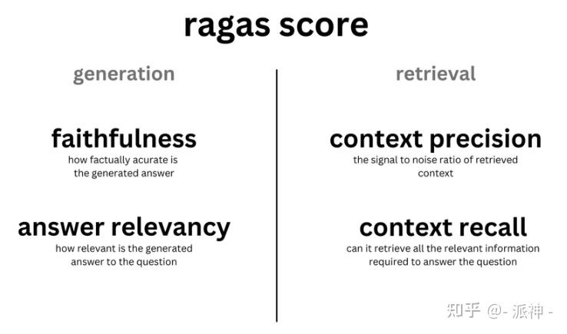
Automated RAG Evaluation Frameworks
Introduce RAGAS (Retrieval-Augmented Generation Assessment)
Inputs:
User query
Retrieved contexts (chunks)
Generated answer
Outputs:
Multiple scalar scores (0–1)
Each score targets a different failure mode.
Original paper: Es, S., James, J., Anke, L. E., & Schockaert, S. (2024, March). Ragas: Automated evaluation of retrieval augmented generation. In Proceedings of the 18th Conference of the European Chapter of the Association for Computational Linguistics: System Demonstrations (pp. 150-158).

Slide 29
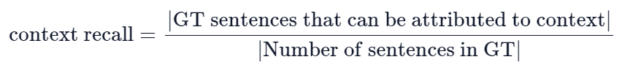
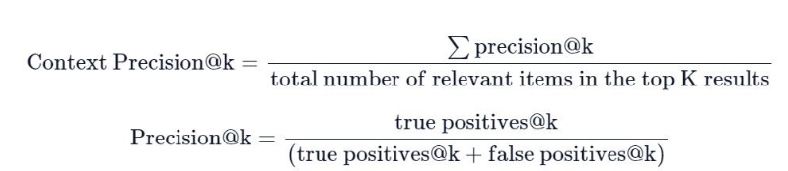



Slide 30
Enterprise Search & QA
Examples:
Internal document QA
Policy / legal search
Technical support systems
Why LLM-IR works well here:
Closed corpus
Clear intent
High cost of wrong answers
User (employee) query:
“Can I work remotely from another country for more than 30 days?”
The organization has:
HR policies
Legal compliance documents
Country-specific tax rules

Slide 31
Feature | Description | Why It Matters for LLM-IR
Closed Corpus | The system only accesses internal, authoritative documents (e.g., HR handbook, legal compliance memos, policy FAQs, country-specific annexes). No open-web or speculative knowledge is used. | The LLM does not need to know the answer from pretraining; it only needs to retrieve and reason over trusted documents, significantly reducing hallucination risk.
Clear Intent | User queries are precise, non-exploratory, and task-oriented (e.g., policy eligibility, procedures, compliance conditions). The goal is to reach a decision, not to explore opinions. | Clear intent aligns well with retrieval, evidence-based summarization, and attribution, enabling accurate ranking and faithful answer generation.
High Cost of Wrong Answers | Incorrect answers can lead to tax violations, employment law issues, or regulatory penalties. Fluency alone is insufficient. | This necessitates faithfulness, grounding, and attribution, making LLM-based IR valuable only when answers are evidence-backed and auditable.

Slide 32
Retrieved Documents (Faithful Retrieval)
1. Remote Work Policy (HR Handbook)
“Employees may work remotely abroad for up to 30 days with manager approval.”
2. Legal Compliance Memo
“Working abroad beyond 30 days may trigger tax residency obligations.”
3. HR FAQ
“Requests exceeding 30 days require legal review.”
✔️ Retrieval is faithful ✔️ Context is relevant

Slide 33
Generated Answer (Strong Example)
Criterion | Outcome
Faithfulness | ✔️ Supported by retrieved docs
Grounding | ✔️ Each claim traceable
Attribution | ✔️ Sources identified
Usefulness | ✔️ Actionable
Risk | ✔️ Low
Generated Answer (Strong Example)
Answer: “Employees may work remotely from another country for up to 30 days with manager approval. Requests exceeding 30 days require legal review due to potential tax and compliance obligations.”
With attribution:
HR Handbook (Remote Work Policy)
Legal Compliance Memo
HR FAQ

Slide 34
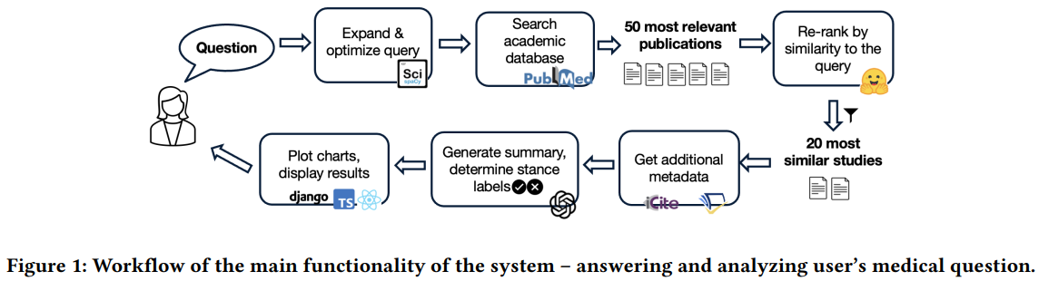
Scientific & Medical IR
Applications:
Literature review assistants
Evidence synthesis
Clinical guideline retrieval
Evaluation standards are stricter — hallucination is unacceptable
An example in CIKM 25:
Vladika, J., & Matthes, F. (2025, November). MedSEBA: Synthesizing Evidence-Based Answers Grounded in Evolving Medical Literature. In Proceedings of the 34th ACM International Conference on Information and Knowledge Management (pp. 6728-6732).

Slide 35
Safety & Evaluation Gate = Zero-Tolerance Rule
A hallucinated fact in web QA = misinformation
A hallucinated fact in medical IR = potential harm
Therefore:
Fluency < Faithfulness
Coverage < Correctness
Answering < Knowing when not to answer
Situation | System Action
No supporting studies | Abstain
Conflicting evidence | Disclose disagreement
Unsupported claim | Blocked output
Weak / outdated evidence | Flag uncertainty

Slide 36
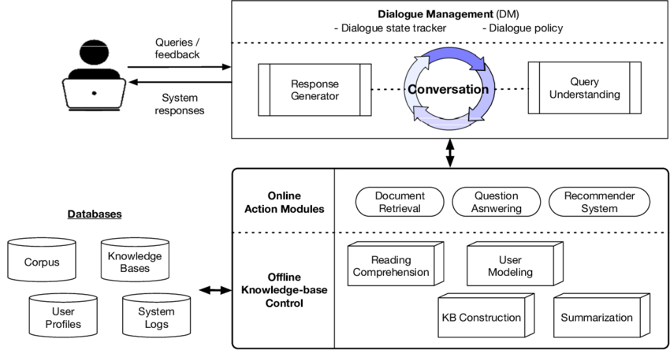
Conversational Search & Assistants
Applications:
Search with follow-up questions
Exploratory information seeking
Introduce idea:
Search becomes a dialogue, not a ranked list.

Slide 37
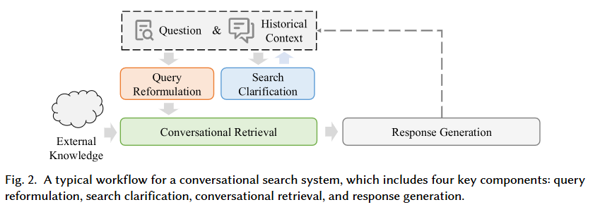
What Changes Compared to Classical IR?
Classical Search | Conversational Search
One-shot query | Multi-turn interaction
Static intent | Evolving intent
Ranked list of documents | Contextual responses
User does the reasoning | System assists reasoning
No memory | Conversation memory
Mo, F., Mao, K., Zhao, Z., Qian, H., Chen, H., Cheng, Y., ... & Nie, J. Y. (2025).
A survey of conversational search. ACM Transactions on Information Systems, 43(6), 1-50.

Slide 38
Open Problems
Reliable evaluation under non-determinism
Faithfulness guarantees
Cost-aware IR pipelines
Domain-specific retrieval grounding

Slide 39

Key LLM & AI conferences and journals
SIGIR: ACM SIGIR Conference on Research and Development in Information Retrieval
Flagship IR conference
Core home for:
Neural IR
LLM-based search
RAG, conversational search
Evaluation and benchmarks
Sets methodological standards for IR
📌 Top venue for LLM-powered search systems
21.5 acceptance rate in 2025 (238/1105)

Slide 40
Key LLM & AI conferences and journals
2️⃣ CIKM ACM Conference on Information and Knowledge Management 27% of acceptance rate
3️⃣ WSDM ACM International Conference on Web Search and Data Mining 17.3% of acceptance rate
4️⃣ ACL (and EMNLP / NAACL) Annual Meeting of the Association for Computational Linguistics 20.3% of acceptance rate
Read paper from that top conferences as they are most up to date

Slide 41

This is just the beginning of your investigation in Information reterival
Read, code and thinking!
Thanks! Q & A

